Slide 1



Copyright for Collaboration
Jessica Coates
Project Manager
Creative Commons Clinic
AUSTRALIA
part of the Creative Commons international initiative
CRICOS No. 00213J

Slide 2


Who owns copyright in wiki content?
AUSTRALIA
part of the Creative Commons international initiative
CRICOS No. 00213J
Notes:
Non-profit
Founded in 2001
These academics became concerned that the default copyright laws that applied in most countries were restricting creativity in the digital environment by preventing people from being able to access, remix and distribute copyright material online
For instances – most people know that it’s currently illegal under Australian law to record a television show to watch later – but did you also know that, in the absence of any licence, it’s also arguably illegal to print off a webpage for personal use, or to use a song in the background of a home video, or a student film
Even those people who want to make their material more freely available can’t do so without hiring lawyers
Taking inspiration from the open source movement, they decided to develop a set of licences that creators could use to make their material more freely available without giving up their copyright
They wanted to replace the standard “all rights reserved” model with a new, more flexible, “some rights reserved”

Slide 3
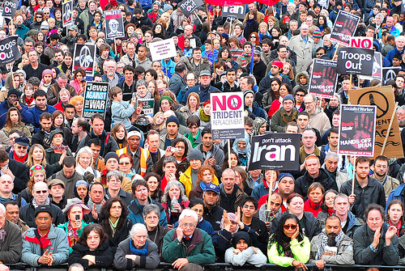
everyone
David Chief, http://www.flickr.com/photos/davidchief/405506361/, Creative Commons Attribution
AUSTRALIA
part of the Creative Commons international initiative
CRICOS No. 00213J
Notes:
Non-profit
Founded in 2001
These academics became concerned that the default copyright laws that applied in most countries were restricting creativity in the digital environment by preventing people from being able to access, remix and distribute copyright material online
For instances – most people know that it’s currently illegal under Australian law to record a television show to watch later – but did you also know that, in the absence of any licence, it’s also arguably illegal to print off a webpage for personal use, or to use a song in the background of a home video, or a student film
Even those people who want to make their material more freely available can’t do so without hiring lawyers
Taking inspiration from the open source movement, they decided to develop a set of licences that creators could use to make their material more freely available without giving up their copyright
They wanted to replace the standard “all rights reserved” model with a new, more flexible, “some rights reserved”

Slide 4
everyone
David Chief, http://www.flickr.com/photos/davidchief/405506361/, Creative Commons Attribution
this makes it hard to share
AUSTRALIA
part of the Creative Commons international initiative
CRICOS No. 00213J
Notes:
Non-profit
Founded in 2001
These academics became concerned that the default copyright laws that applied in most countries were restricting creativity in the digital environment by preventing people from being able to access, remix and distribute copyright material online
For instances – most people know that it’s currently illegal under Australian law to record a television show to watch later – but did you also know that, in the absence of any licence, it’s also arguably illegal to print off a webpage for personal use, or to use a song in the background of a home video, or a student film
Even those people who want to make their material more freely available can’t do so without hiring lawyers
Taking inspiration from the open source movement, they decided to develop a set of licences that creators could use to make their material more freely available without giving up their copyright
They wanted to replace the standard “all rights reserved” model with a new, more flexible, “some rights reserved”

Slide 5
You need a licence
AUSTRALIA
part of the Creative Commons international initiative
CRICOS No. 00213J
Notes:
Non-profit
Founded in 2001
These academics became concerned that the default copyright laws that applied in most countries were restricting creativity in the digital environment by preventing people from being able to access, remix and distribute copyright material online
For instances – most people know that it’s currently illegal under Australian law to record a television show to watch later – but did you also know that, in the absence of any licence, it’s also arguably illegal to print off a webpage for personal use, or to use a song in the background of a home video, or a student film
Even those people who want to make their material more freely available can’t do so without hiring lawyers
Taking inspiration from the open source movement, they decided to develop a set of licences that creators could use to make their material more freely available without giving up their copyright
They wanted to replace the standard “all rights reserved” model with a new, more flexible, “some rights reserved”

Slide 6

Approaches
Assign all copyright to one entity
  good for ‘closed’ wikis – but no one else can use the material
Write a specific licence for your wiki
  again, good for ‘closed’ wikis – but lots of work
Use open content licence
  most common approach for public wikis (like Wikipedia)
AUSTRALIA
part of the Creative Commons international initiative
CRICOS No. 00213J
Notes:
Non-profit
Founded in 2001
These academics became concerned that the default copyright laws that applied in most countries were restricting creativity in the digital environment by preventing people from being able to access, remix and distribute copyright material online
For instances – most people know that it’s currently illegal under Australian law to record a television show to watch later – but did you also know that, in the absence of any licence, it’s also arguably illegal to print off a webpage for personal use, or to use a song in the background of a home video, or a student film
Even those people who want to make their material more freely available can’t do so without hiring lawyers
Taking inspiration from the open source movement, they decided to develop a set of licences that creators could use to make their material more freely available without giving up their copyright
They wanted to replace the standard “all rights reserved” model with a new, more flexible, “some rights reserved”

Slide 7
Open content licences
Exact definition controversial, but in general:
retain copyright
provide permission in advance for certain uses
standardised terms
non-discriminatory
at a minimum provide the right to reproduce, copy and communicate - under prescribed terms
AUSTRALIA
part of the Creative Commons international initiative
CRICOS No. 00213J
Notes:
Non-profit
Founded in 2001
These academics became concerned that the default copyright laws that applied in most countries were restricting creativity in the digital environment by preventing people from being able to access, remix and distribute copyright material online
For instances – most people know that it’s currently illegal under Australian law to record a television show to watch later – but did you also know that, in the absence of any licence, it’s also arguably illegal to print off a webpage for personal use, or to use a song in the background of a home video, or a student film
Even those people who want to make their material more freely available can’t do so without hiring lawyers
Taking inspiration from the open source movement, they decided to develop a set of licences that creators could use to make their material more freely available without giving up their copyright
They wanted to replace the standard “all rights reserved” model with a new, more flexible, “some rights reserved”

Slide 8

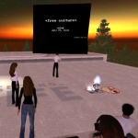

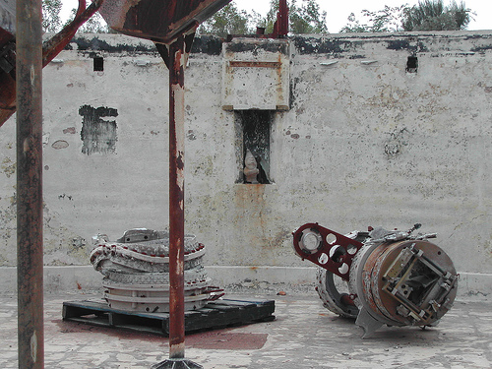
Why OCL?
Facilitates collaboration
Increases reach and reputation
Gives new value to otherwise stagnant material
Community engagement
Reduced admin
Legal clarity
Increases sum of human knowledge, encourages innovation
AUSTRALIA
part of the Creative Commons international initiative
CRICOS No. 00213J

Slide 9

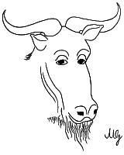


Licences
GNU Free Document Licence (GFDL) – used by Wikipedia
Other systems/terms: copyleft, free culture, Debian, Free Software Foundation
Most widespread for creative content – Creative Commons
AUSTRALIA
part of the Creative Commons international initiative
CRICOS No. 00213J
Notes:
Standard copyright law says that you can’t reproduce or communicate creative material (eg movies, books, music etc) without the copyright owner’s permission, except in very limited circumstances
The problem with this in the digital era is that every use of material makes a reproduction. This includes just viewing
This means that, under the default copyright laws, printing out a webpage, emailing a picture to your friend, making a digital collage or remix work etc will all generally infringe copyright

Slide 10
Creative Commons
A set of licences designed to:
  facilitate sharing;
  be flexible;
  be easy to use and understand; and
  apply in the same way anywhere in the world.
AUSTRALIA
part of the Creative Commons international initiative
CRICOS No. 00213J
Notes:
Non-profit
Founded in 2001
These academics became concerned that the default copyright laws that applied in most countries were restricting creativity in the digital environment by preventing people from being able to access, remix and distribute copyright material online
Taking inspiration from the open source movement, they decided to develop a set of licences that creators could use to make their material more freely available without giving up their copyright
They wanted to replace the standard “all rights reserved” model with a new, more flexible, “some rights reserved”

Slide 11
Benefits of using CC
designed for collaboration
ready to use and free – no lawyers needed
established system – easy to use
worldwide application and recognition
Searchable metadata
compatible with other CC material – approx 100 million web objects
AUSTRALIA
part of the Creative Commons international initiative
CRICOS No. 00213J

Slide 12




Licences
4 licence elements:
        Attribution – attribute the author
        Noncommercial – no commercial use
        No Derivative Works – no remixing
        ShareAlike – remix only if you let others remix
AUSTRALIA
part of the Creative Commons international initiative
CRICOS No. 00213J
Notes:
The first CC licences were released in 2002
The central to each of the CC licences are the four licence elements – Attribution, noncommercial, no derivative and sharealike
These represent restrictions that copyright owners may want to put on how people can use their material.
As you can see, each of the elements has a symbol that can be used to ‘represent’ each of these elements
this makes the licences easier understand – in theory, once a person is familiar with the CC licences, they should be able to recognise what uses are allowed simply by looking at the symbols

Slide 13
Licences
creators mix and match these elements to make a licence eg:
  Attribution-Noncommercial-ShareAlike – can remix, tweak, and build upon the work, as long as:
    you credit the author;
    it is for non-commercial purposes; and
    you license your new creations under the same licence
AUSTRALIA
part of the Creative Commons international initiative
CRICOS No. 00213J
Notes:
Users can mix and match these elements to set the conditions of use for their material
So, for example, an author may be happy to allow private uses of their work, but may want to limit how it can be used commercially.
They may also want people to remix their work, but only so long as that person attributes them and makes the new work available for others to remix
So they can choose the Attribution-noncommercial-sharealike licence

Slide 14
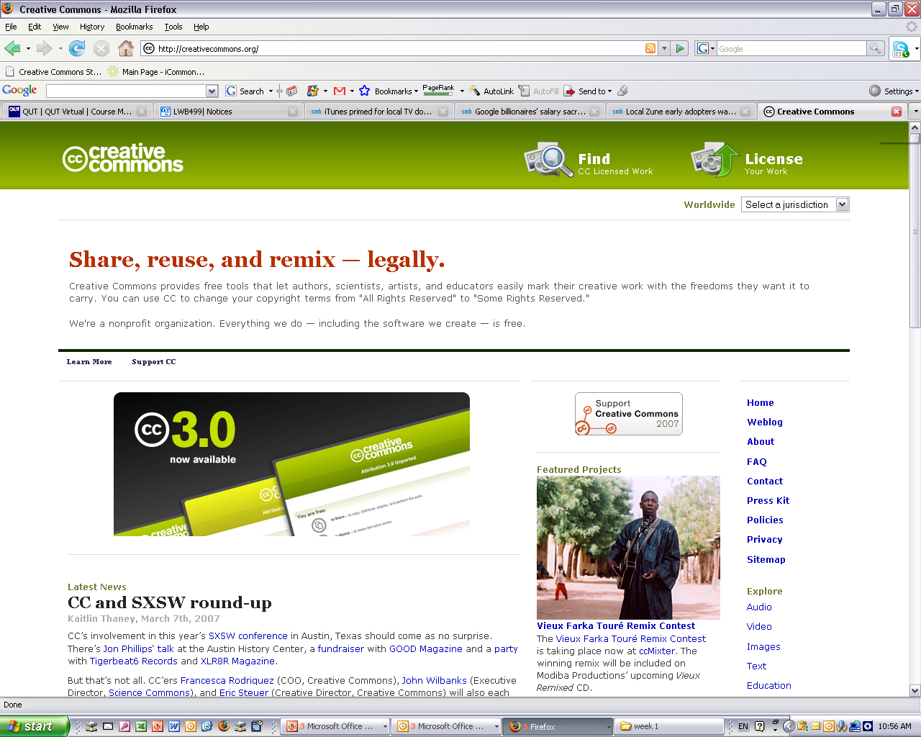
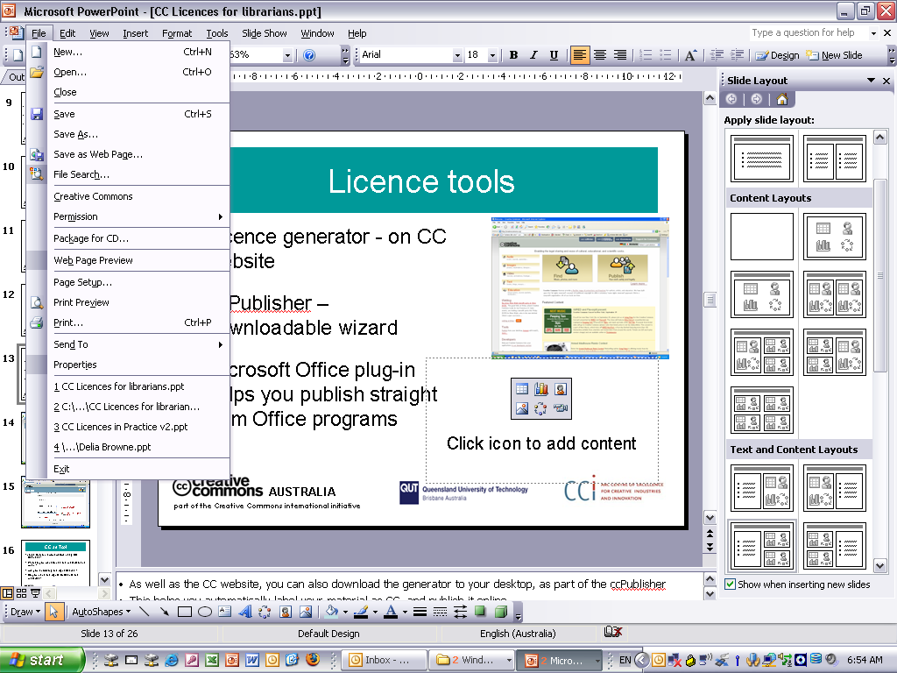
Licensing Tools
Licence generator – simple questions choose right licence
Also available:
  ccPublisher – downloadable desktop wizard
  Microsoft plug-in –allows you to CC license straight from Office programs
  Individual site generators eg Flickr
AUSTRALIA
part of the Creative Commons international initiative
CRICOS No. 00213J
Notes:
As well as the CC website, you can also download the generator to your desktop, as part of the ccPublisher
This helps you automatically label your material as CC, and publish it online
In an interesting development, Microsoft has also recently released an plugin that allows you to label any work created in an Office as CC.
A number of sites also let you licence your material as cc – including flickr, and blip.tv

Slide 15
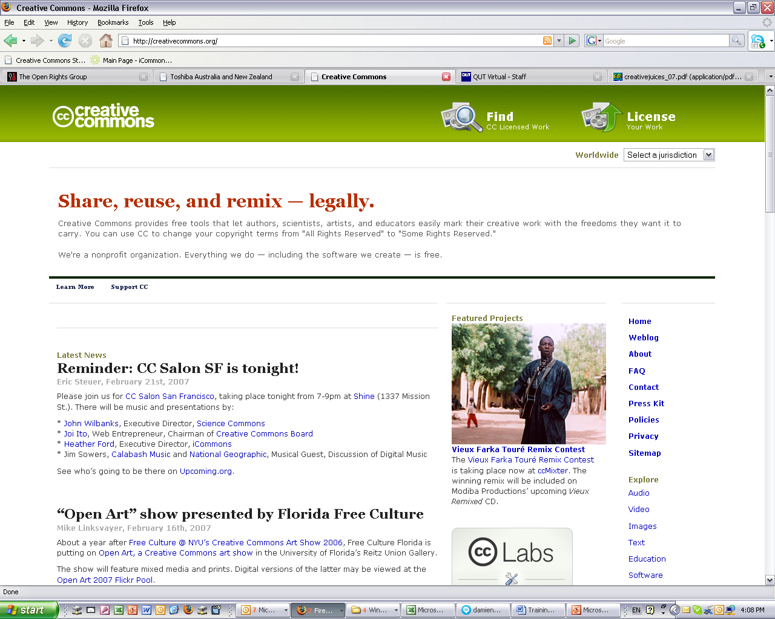
Licences
AUSTRALIA
part of the Creative Commons international initiative
Notes:
To help choose the most appropriate licence, the CC website provides a “licence generator”, which asks simple questions to determine what people are happy to use

Slide 16
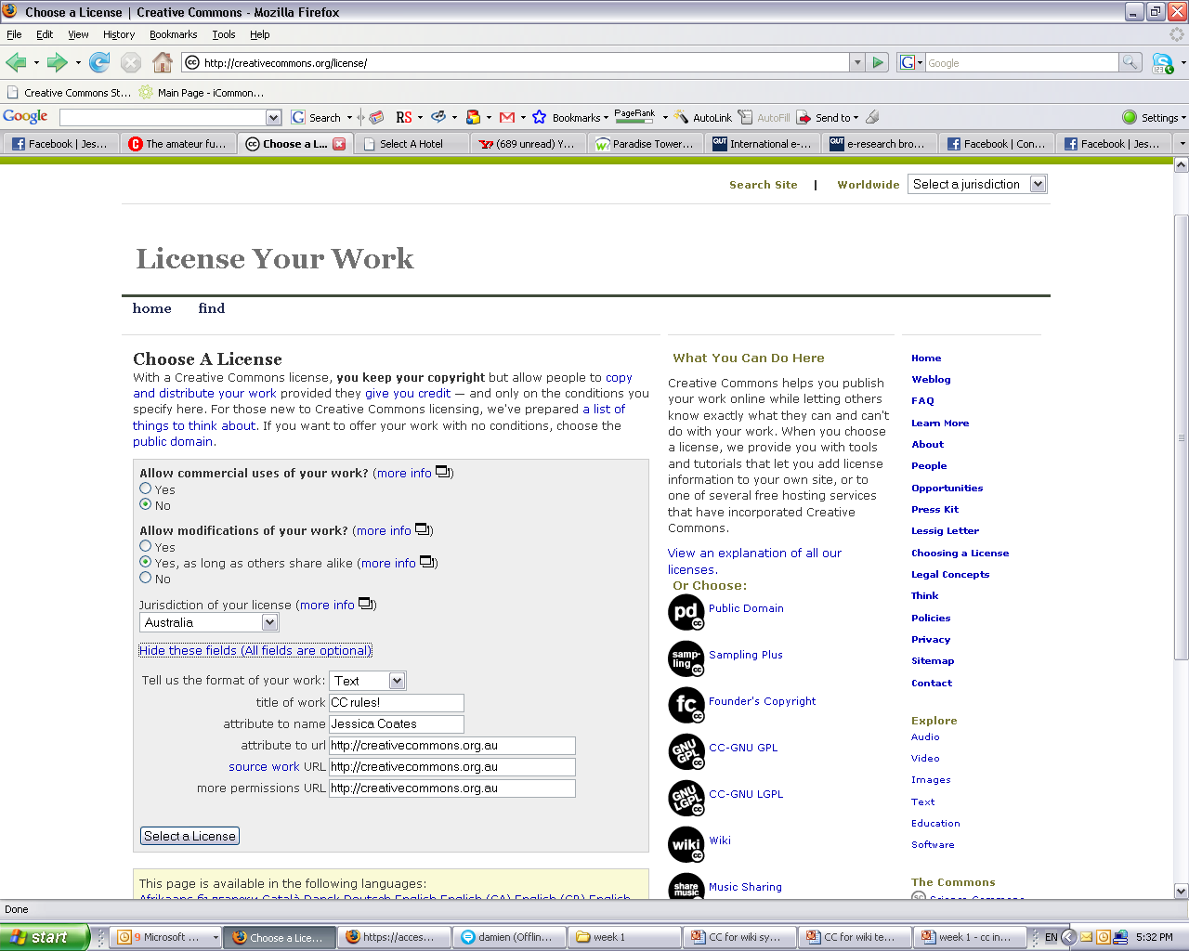
Licences
AUSTRALIA
part of the Creative Commons international initiative

Slide 17
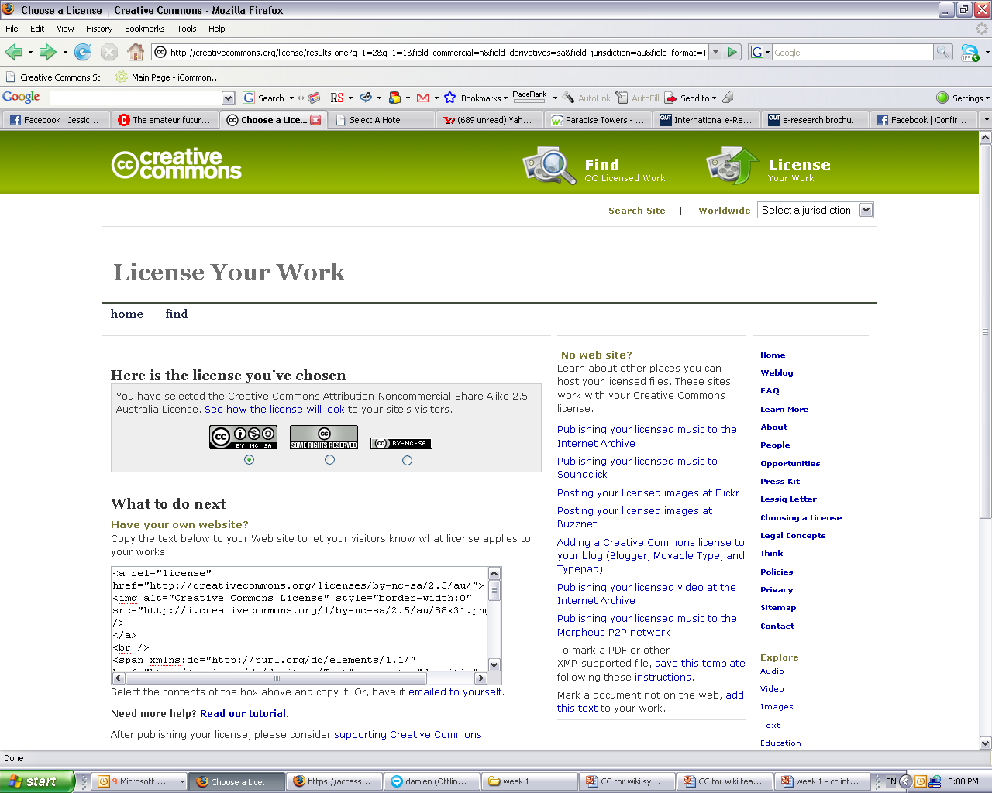
Licences
AUSTRALIA
part of the Creative Commons international initiative
Notes:
Selecting a licence takes you through to a page that provides you with some XHTML text that you can copy onto you website
This basically ‘embeds’ the cc licence into your work, and displays the ‘licence button’ on your site
By clicking on the button, you’re taken through. . .

Slide 18
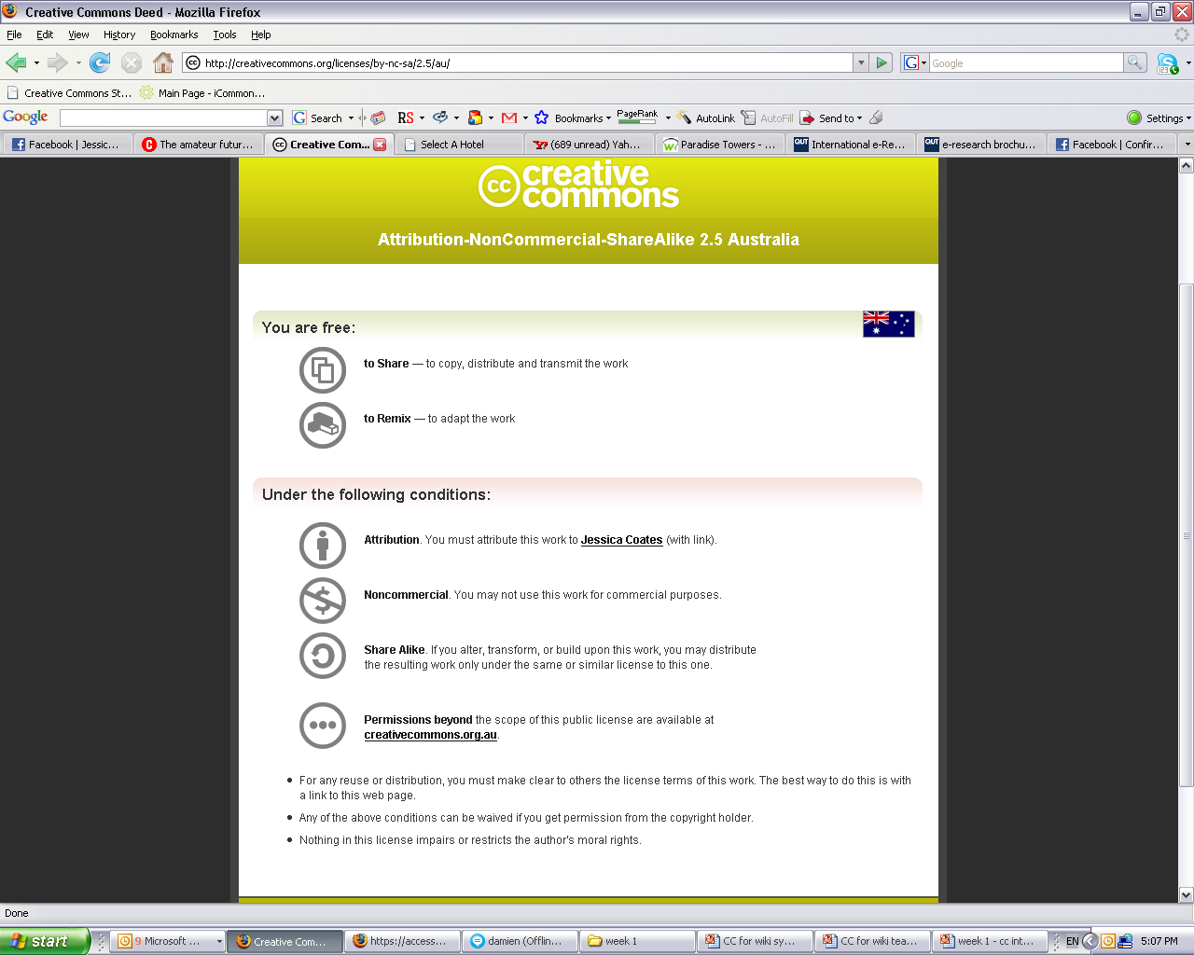
Licences
AUSTRALIA
part of the Creative Commons international initiative
Notes:
. . .to the licence deed, which sets out the licence in plain english terms
You can see the licence element symbols here
By clicking on this link here, you can access . . .

Slide 19
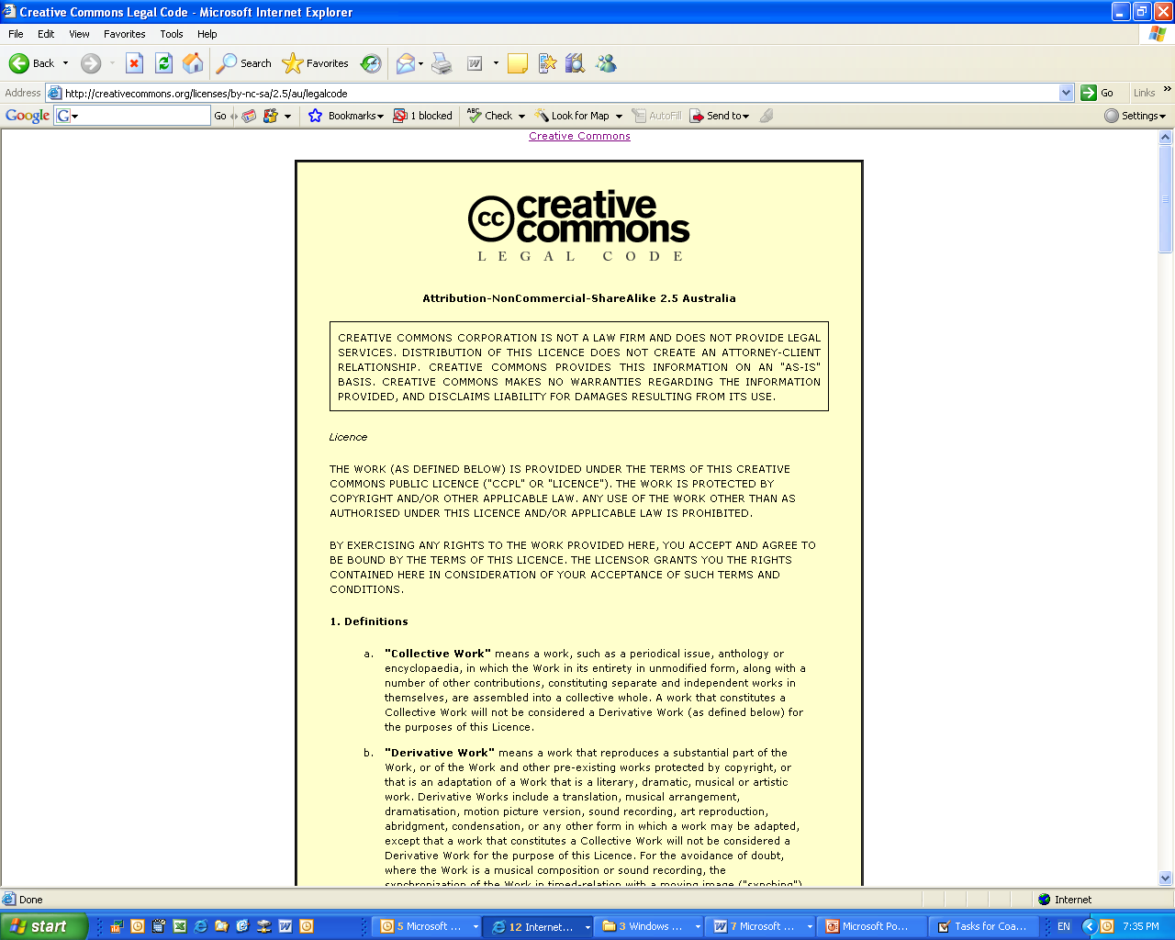
Licences
AUSTRALIA
part of the Creative Commons international initiative
Notes:
The full licence code – which sets out the licence in full legal terms

Slide 20
Best licence for wikis?
Attribution?
  compulsory – can specify form of attribution
Noncommercial?
  if want to use commercially may need extra agreement
No Derivatives?
  doesn’t allow collaboration
ShareAlike?
  requires any downstream uses to be ShareAlike too
SO Attribution best; Attribution-Noncommercial ok
AUSTRALIA
part of the Creative Commons international initiative
CRICOS No. 00213J

Slide 21
Things to think about
Who do you want to use the material, and when?
CC is global & perpetual
Are you choosing the right licence? commercial use?
Do you have the rights to license? 3rd party permissions
AUSTRALIA
part of the Creative Commons international initiative
CRICOS No. 00213J

Slide 22
One last plug
CC is also a good place to find photos, videos, articles, music for inclusion in wikis/teaching materials
http://search.creativecommons.org
(can also find using Google, Yahoo, Firefox and Flickr)
AUSTRALIA
part of the Creative Commons international initiative
CRICOS No. 00213J

Slide 23
Thanks
http://www.creativecommons.org
http://www.creativecommons.org.au
info@creativecommons.org.au
This slide show is licensed under a Creative Commons Australia Attribution licence. For more information see http://creativecommons.org/licenses/by/2.5/au/.
AUSTRALIA
part of the Creative Commons international initiative
CRICOS No. 00213J

